Slide 1
Lesson 16: Basic Control Modes
ET 438a Automatic Control Systems Technology

Slide 2
Learning Objectives
After this presentation you will be able to:
Describe the common control modes used in analog control systems
List the characteristics of common control modes
Write the time, Laplace and transfer functions of common control modes
Identify the Bode plots of common control modes
Design OP AMP circuits that realize theoretical control mode performance.

Slide 3
Control Modes-Proportional Control Action
Process characteristics for optimum results:
1) Small process capacitance
2) Rapid load changes
Limitations: Small steady-state error may require high gain to achieve acceptable error levels
Mathematical representations
Where: e = time domain error signal
K_{p} = proportional gain
v_{o} = controller output with e=0
v = controller time domain output
Time function:
Laplace function:
Note: Initial condition v_{o}=0 on
Laplace function
Transfer function:

Slide 4
Proportional Control Frequency Response
Bode plots of three values of K_{p}:
K_{p1}=0.1,
K_{p2}=1,
and K_{p3}=100
K_{p3}
Note: gain is independent
of frequency.
Practical realization:
Non-inverting OP AMP
circuit
K_{p2}
K_{p1}

Slide 5
Motor Speed Control
Example 16-1: Determine the effect of applying proportional control to the block diagram shown below. The motor produces the following results with the control loop open:
T_{L1} = 0.05 N-m T_{L2} = 0.075 N-m (50% increase in load)
V_{T} = 19.24 Vdc V_{T}=19.24
I_{a1} = 1.033 A I_{a2} = 1.45 A
ω₁ = 300 rad/sec ω₂ = 291.7 rad/sec
r
+
e
v
V_{T}
ω
Controller K_{p}
Power Supply G_{amp}
Motor & Load
-
c_{m}
Tach Generator, K_{tac}

Slide 6
Motor Speed Control
Motor Parameters:
T_{f} = 0.012 N-m R_{a} = 1.2 ohms
K_{T} = 0.06 N-m/A K_{tac} = 0.11 V-sec/rad
K_{e} = 0.06 V-sec/rad K_{p}G_{amp} = 10 V/V
Solution: Find the error produced and the setpoint value, r. Then write equations around control loop.
r
+
e₁
K_{p}G_{amp}=10
V_{T} = 19.24 V
-
c_{m1}
K_{tac}= 0.11 V-s/rad
ω =300 rad/sec

Slide 7
Example 16-1 Solution (2)
Combine equations
Substitute values
Simplify
Compute error
Substitute values
Simplify
The initial setpoint value of r=34.924 V with an error of 1.924 V at a speed of 300 rad/s and T_{L1}=0.05 N-m

Slide 8
Example 16-1 Solution (3)
When torque increase to T_{L2}=0.075 N-m new V_{T} is defined by…
Substitute in Tachometer formula
Since setpoint, r does not change error must change due to measured speed change.
Motor equations
Combine these equations to get:
Need two equations to find both V_{T2} and ω_{m2}.

Slide 9
Example 16-1 Solution (4)
Substitute in known values and simplify equation to get first relationship.
r₁=34.924 V K_{p}G_{amp}=10 K_{tac} = 0.11 V-s/rad
Equation 1
Now use the motor armature circuit equation and the armature current for T_{L2} =0.075 N-m to find second independent equation.
I_{a2} =1.45 A K_{e} = 0.06 V-s/rad R+ =1.2 ohms
Equation 2

Slide 10
Example 16-1 Solution (5)
Place equations (1) and 2) into standard form and solve simultaneously using software or calculator.
Answers
Now compute the error signal from the new tachometer output voltage c_{m2}.
Error increases e₂>e₁ 1.968>1.924 V to rebalance system

Slide 11
Example 16-1 Solution (6)
Now determine the percentage speed changes for open loop and feedback control. Setpoint, r=300 rad/sec
Open loop speed change
Answers
Feedback loop speed change
Feedback reduces speed error by factor of 19.35
Answers

Slide 12
Integral Control Mode
Integral Mode characteristics:
1) Output is integral of error over time
2) Drives steady-state error to zero
3) Adds pole to transfer function at s=0 (infinite gain to constant)
4) Integrators tend to make systems less stable
Equations
Where K_{I} = integral gain constant
Time:
Laplace:
Transfer Function:

Slide 13
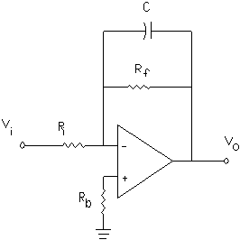
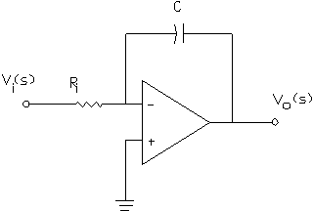
OP AMP Realizations of Integral Control
Practical OP AMP Integrator
Ideal OP AMP Integrator
Transfer Function
Transfer Function
One pole at s=0
One pole at s=-1/R_{f}∙C

Slide 14
Bode Plots of Integrator Circuits
Substitute jω for s and find the magnitude and phase shift of the transfer function for different values of ω.
Ideal Integrator
Practical Integrator
Take magnitude and phase shift of each of these functions using rules of complex numbers.
z=a+jb
Magnitude of z: z=|z|
Phase Shift
Scale for dB

Slide 15
Bode Plots of Integrator Circuits
Practical Integrator Circuit
Taking magnitude gives
Phase Shift gives
180 degree phase shift is from inverting configurations
Ideal Integrator Circuit
Magnitude gives
Phase shift

Slide 16
Integrator Bode Plots Using MatLAB
Use MatLAB script to generate Bode plots and transfer function.
Define parameters: R_{i} = 10 kΩ, R_{f} = 100 kΩ, C = 0.01 μF
MatLAB Script
ri=input('Enter value of input resistance: ');
c=input('Enter value of capacitance: ');
rf=input('Enter value of feedback resistance: ');
% compute transfer function model parameters for
% practical integrator
tau=rf*c;
ki=-rf./ri;
Input statement
Comments begin with %

Slide 17
Integrator Bode Plots Using MatLAB
MatLAB Script (Continued)
% compute parameter for ideal integrator
tau1 = ri*c;
% build transfer functions
% denominator form is a1*s^2+a2s+a3
Av=tf([ki],[tau 1])
Av1=tf([-1],[tau1 0])
%plot both on the same graphs
bode(Av,Av1);
Create transfer functions
Plot both graphs on same figure

Slide 18
Integrator Bode Plots Using MatLAB
ω=1/R_{i}C
ω=1000 rad/s

Slide 19
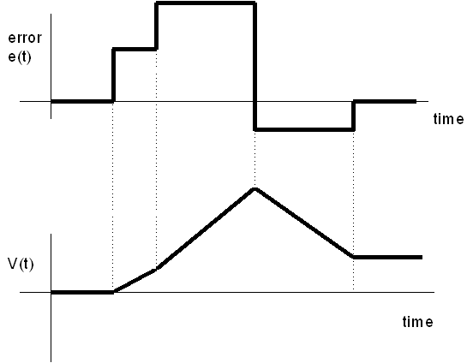
Integral Action on Time Varying Error Signals
Integral of constant, k, is line with slope k.
Integrator produces a linearly increasing output for constant error input
e₂
e₁
e₄=0
Negative error causes decreasing output
-e₃
V(t)=-e₃t
Zero error maintains last output value
V(t)=e₂t
V(t)=e₁t

Slide 20
Estimating Integrator Output
From Calculus, integral is sum of area below a function plot
f(t)
f(t_{i+1})
t
a
Δt
b
For linear error plots, integral is the sum of the areas of linear segments.
Use triangle, trapezoid, and rectangle formulas to approximate output

Slide 21
Integrator Output
Example 16-2: An ideal integrator has a gain of K_{I} =0.1 V/s. Its initial output is v=1.5 V. Determine the integrator outputs if the error has step increases given by the table below.
Error Magnitude (V) | Time Interval
e(t)=0 | 0≤t≤1 seconds
e(t)=2.5 | 1<t≤2 seconds
e(t)=4 | 2<t≤3 seconds
e(t)=0 | 3<t≤4 seconds
e(t)=-1.5 | 4<t≤5 seconds

Slide 22
Example 16-2 Solution (1)
Plot the error function that is input to the integrator

Slide 23
Example 16-2 Solution (1)
Use the approximate formula to find the error at the end of each interval
V₀=1.5
A₀=K_{I}∙Δt∙e₀ =0.1(1)(0) =0
V₁=1.5+A₀=1.5+0=1.5
A₂
A₁=K_{I}∙Δt∙e₁ =0.1(1)(2.5) =0.25
V₂=1.5+A₁=1.5+0.25=1.75
A₁
A₃
A₂=K_{I}∙Δt∙e₂ =0.1(1)(4) =0.40
V₃=1.75+A₂=1.75+0.40=2.15
A₄
A₃=K_{I}∙Δt∙e₃ =0.1(1)(0) =0
A₀
V₄=2.15+A₃=2.15+0.0=2.15
A₄=K_{I}∙Δt∙e₄ =0.1(1)(-1.5) =-0.15
V₅=2.15+A₄=2.15+-0.15=2.00

Slide 24
Example 16-2 Solution (2)
Integrator output plot

Slide 25
Derivative Control Mode
Derivative Control Characteristics:
Produces output only when error is changing
Output is proportional to rate of change in error
Derivative control never used alone
Used with proportional and/or integral modes
Anticipates error by observing the rate of change

Slide 26
Derivative Mode Equations
Time Equation:
Laplace Equation:
Transfer Function Equation:
Differentiators are high-pass filters to sinusoidal signals. They increase sensitivity to rapid error changes when added to controllers.

Slide 27
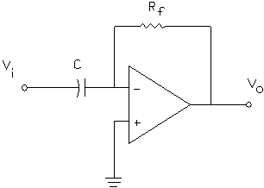
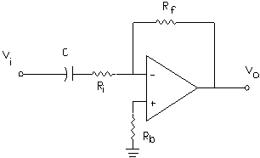
OP AMP Realizations of Differentiators
Ideal OP AMP Differentiator
Practical OP AMP Differentiator
Transfer Function
Transfer Function
Introduces: zero at s=0
pole at s=-1/R_{i}∙C
Introduces one zero at s=0

Slide 28
Bode Plots of Differentiators
Ideal Differentiator Equations
Practical Differentiator Equations
Use MatLAB script to generate Bode plots and transfer function.
Define parameters: R_{i} = 10 kΩ, R_{f} = 100 kΩ, C = 0.01 μF

Slide 29
Bode Plots of Differentiators
ω=1/R_{i}C

Slide 30
End Lesson 16: Basic Control Modes
ET 438a Automatic Control Systems Technology

